Slide 1
Sales Performance Dashboard using Power BI
Dashboard Design and Business Intelligence Analysis

Slide 2
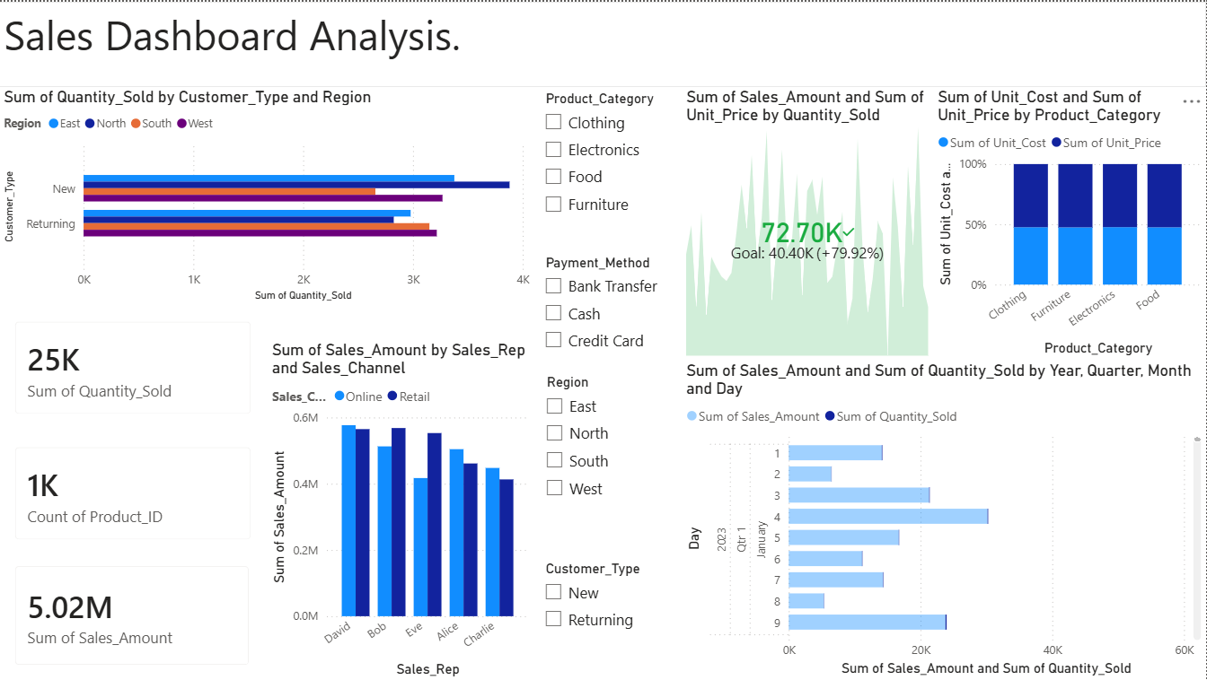

Slide 3
Objective & Dataset
Objective
Design an interactive business dashboard using Power BI.
Analyse sales performance across regions, products, and sales channels.
Provide actionable insights for business stakeholders.
Dataset
Sales Financial Dataset (Kaggle)
Fields used:
Sales Amount
Quantity Sold
Product Category
Region
Customer Type
Sales Channel
Sales Representative
Sale Date

Slide 4
Key Insights
Sales Performance
Total revenue exceeded 5 million.
Significant variation exists across product categories.
Regional sales performance differs between customer segments.
Sales Representatives
Some representatives consistently outperform others.
Online and retail channels contribute differently to revenue.
Customer Analysis
New and returning customers show distinct purchasing behaviours.
Regional demand patterns can guide future sales strategies.

Slide 5
Conclusion and Recommendations
Conclusion
The dashboard provides a comprehensive view of business performance.
Interactive filters allow stakeholders to explore data dynamically.
Visual insights support informed decision-making.
Recommendations
Focus on high-performing product categories.
Strengthen sales strategies in lower-performing regions.
Monitor monthly sales trends for forecasting and planning.

